Slide 1
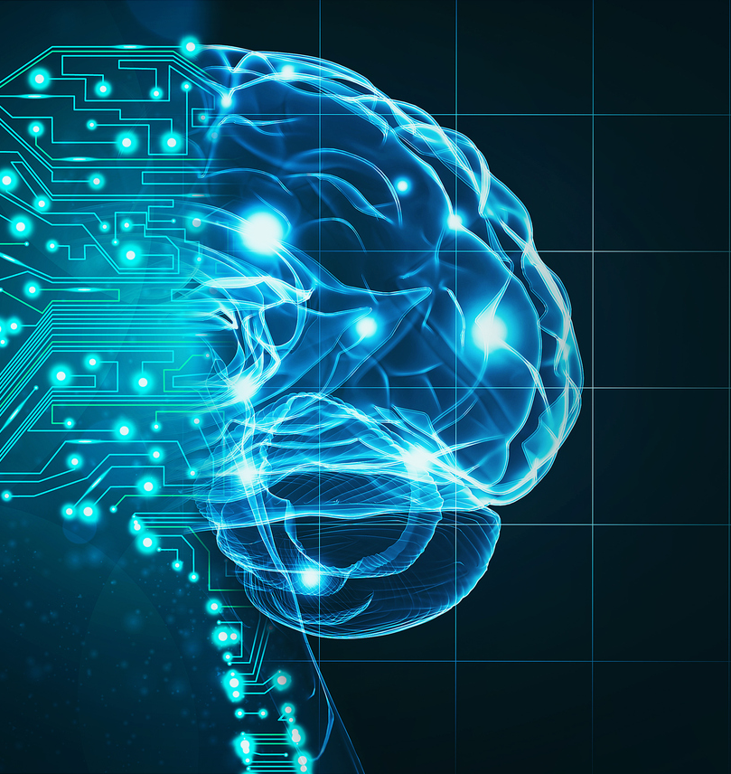
β-VAE: semantic disentanglement in inferotemporal face patch neurons
Matteo Marturini, University of Trieste, Msc Data Science and Scientific Computing
Notes:
The goal of this project is to present a recent study that demonstrated that the beta VAE can discover latent units that have a strong correspondence with single neuron response in the face patch system of the inferotemporal cortex, which are specific networks of neurons in primates involved in face detection and recognition.

Slide 2
Outline
β-VAE
Semantic disentanglement in single inferotemporal face patch neurons
Practical implementation
Notes:
First, I’m going to review the papers in which the betaVAE was introduced, with particular attention to its disentanglement property
Then I’m going to explain how this architecture was able to model the brain of primates
And lastly I’m going to present a small implementation of BetaVAE on a dataset

Slide 3
β-VAE
Notes:
First quick recap of VAE

Slide 4
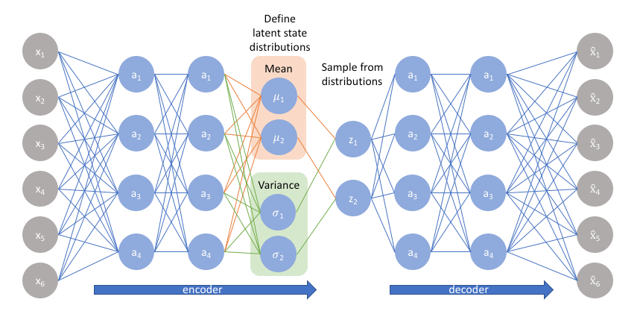
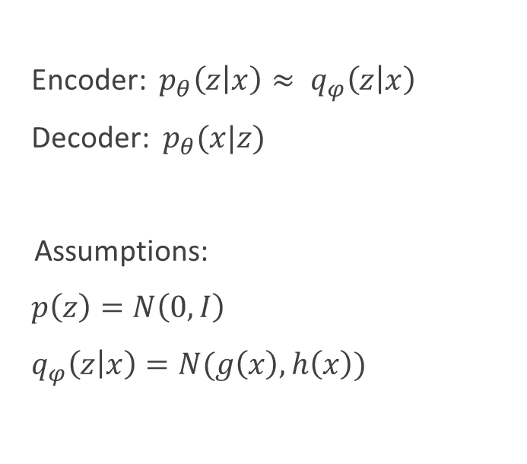
VAE
Encoder: ${ p}_{θ}\left(z | x\right)≈ q_{φ}\left(z | x\right)$
Decoder: $p_{θ}(x|z)$
Assumptions:
$p\left(z\right)=N\left(0,I\right)$
$q_{φ}\left(z | x\right)=N(g\left(x\right),h\left(x\right))$
https://www.jeremyjordan.me/variational-autoencoders/
Notes:
Gen model composed of 2 archit
More formally: prob distributions
assumptions

Slide 5
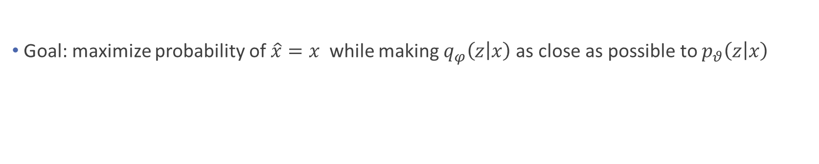
VAE
Goal: maximize probability of$\hat{x}=x$while making $q_{φ}\left(z | x\right)$as close as possible to $p_{θ}\left(z | x\right)$
$$L_{θ,φ}=E_{z\sim q_{φ}\left(z | x\right)}\left[\log{p_{θ}\left(x | z\right)}\right]−D_{KL}\left[q_{φ}\left(z | x\right)||p_{θ}(z)\right]$$
Notes:
Given this framwork: the goal …
After algebraic manip it can be showned that …

Slide 6
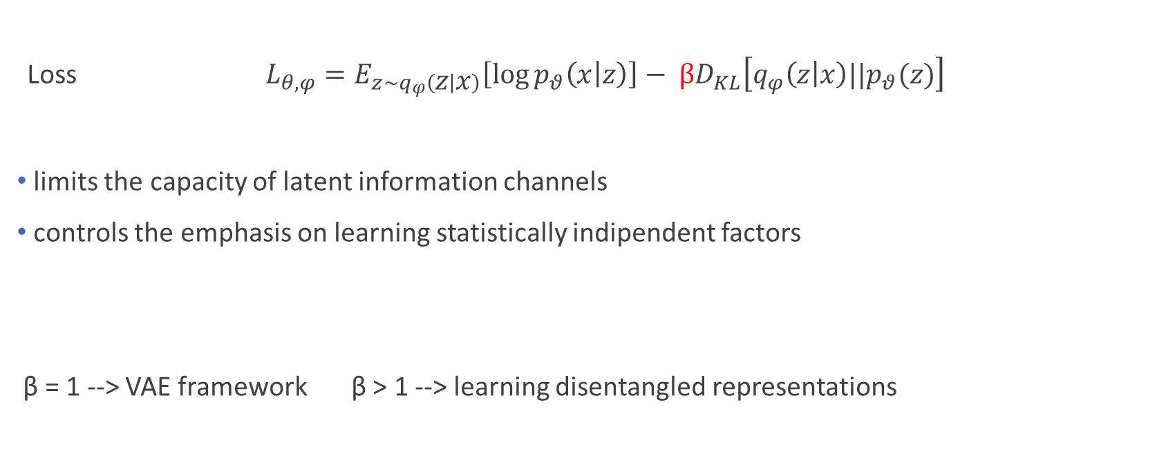
β-VAE
Loss $L_{θ,φ}=E_{z\sim q_{φ}\left(z | x\right)}\left[\log{p_{θ}\left(x | z\right)}\right]− βD_{KL}\left[q_{φ}\left(z | x\right)||p_{θ}(z)\right]$
limits the capacity of latent information channels
controls the emphasis on learning statistically indipendent factors
β = 1 --> VAE framework β > 1 --> learning disentangled representations
Notes:
Beta VAE differs from VAE by introducing hyperpar
Effects are 2, explain in a while how this hyperp is able to achieve these effects
If we set …

Slide 7
Disentanglement in β-VAE
Notes:
Going to present in more details the theoretical foundations of the betaVAW and how it works proposed in the papers where betaV was introduced

Slide 8
Disentangled representations
Assumption: subset of generative factors that generated the data
latent units must be sensitive to changes in single generative factors while being invariant to others
example: faces
indipendent
interpretable
Higgins et al. β-VAE: learning basic visual concepts with a constrained variational framework, (2017)
Notes:
But first I’m going to define what are disentagled representations
The assumpt, …
Latent units to be disentangled must satisty these properties, which means that …
We can think of as generative factor the dimension of the chin ofr example, betaV has to discover a unit which by tweaking it we just modify dim of chin for example

Slide 9
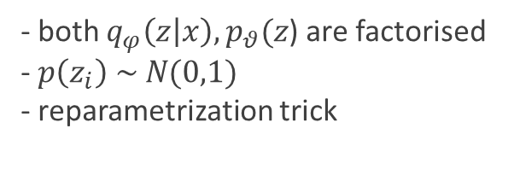
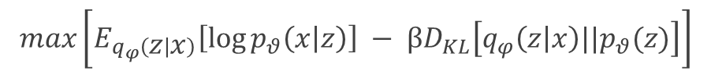
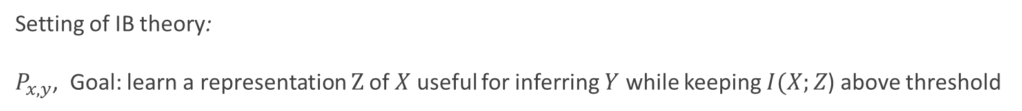
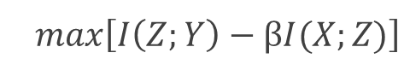
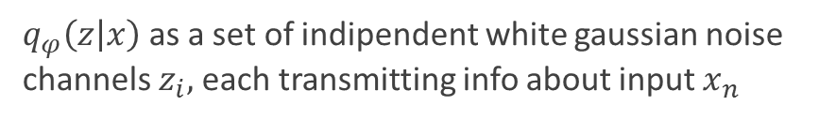
Information bottleneck principle
Setting of IB theory:
$P_{x,y}$, Goal: learn a representation $Z$of $X$ useful for inferring $Y$ while keeping $I(X;Z$) above threshold
$max\left[I\left(Z;Y\right)−βI(X;Z)\right]$
$$max\left[E_{q_{φ}\left(z | x\right)}\left[\log{p_{θ}\left(x | z\right)}\right] − βD_{KL}\left[q_{φ}\left(z | x\right)||p_{θ}(z)\right]\right]$$
- both $q_{φ}\left(z | x\right), p_{θ}(z$) are factorised
- $p\left(z_{i}\right) \sim N(0,1)$
- reparametrization trick
$q_{φ}\left(z | x\right)$ as a set of indipendent white gaussian noise channels $z_{i},$each transmitting info about input $x_{n}$
Burgess et al., Understanding disentanglement in β-VAE, (2018).
Notes:
To gain insights into how the betaVAE is able to learn disentangled rep, paper proposed view learning obj under lens of info theory, in part IB
General setting of IB is …
Analogy
Given the fact that,…

Slide 10
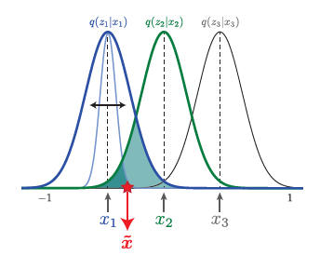

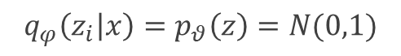
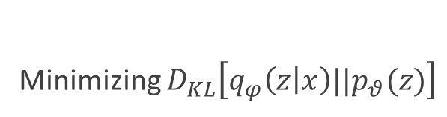
Learning pressure
Minimizing $D_{KL}\left[q_{φ}\left(z | x\right)||p_{θ}(z)\right]$
$$q_{φ}\left(z_{i} | x\right)=p_{θ}\left(z\right)=N(0,1)$$
Cost in terms of reconstruction quality
Latent channels $z_{i}$ have no capacity
Solution:
Embed the data points on a set of representational axes where nearby points on the axes are also close in data space
Burgess et al., Understanding disentanglement in β-VAE, (2018).
Notes:
Given this interpretation, in order to optimize the objective function of the betaVAE framework, we want to minimize …
This means …
As a consequence we loose recon quality because
A solution to both max recon quality and min KL is to embed …

Slide 11
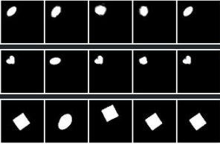
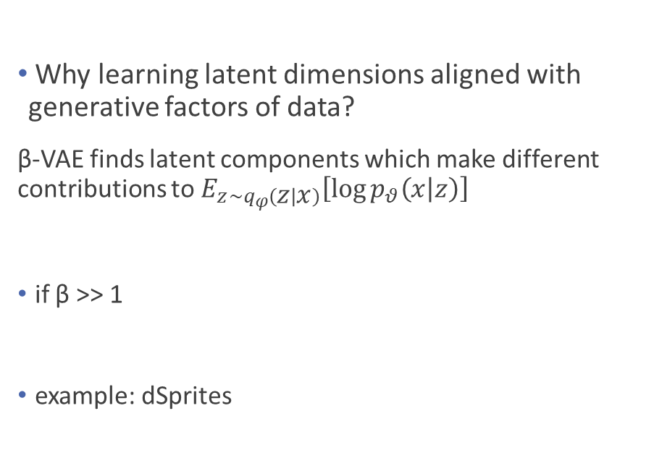
Latent dimensions alignment
Why learning latent dimensions aligned with generative factors of data?
β-VAE finds latent components which make different contributions to $E_{z\sim q_{φ}\left(z | x\right)}\left[\log{p_{θ}\left(x | z\right)}\right]$
if β >> 1
example: dSprites
Encode info which yields most significant improvement in log likelihood term
Burgess et al., Understanding disentanglement in β-VAE, (2018).
Notes:
Now that we know what the learning pressure is pushing towards, an open question still is how latent …
The answer proposed by the paper is …
To better understand, suppose we are in scenario where … the best thing we can do
As an example

Slide 12
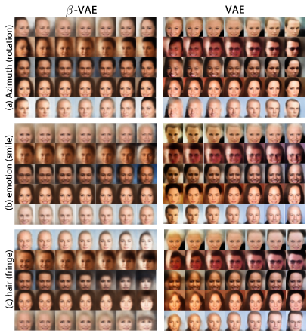
Results
CelebA
Latent traversal
Disentangled representations
Higgins et al. β-VAE: learning basic visual concepts with a constrained variational framework, (2017)
Notes:
In this slide I’m just going to report some results obtained by betaVAe on 2 datasets
CelebA,
In this image are reported the traversal of the latent units, so basically what they did, gave an image to the encoder, sampled latent unit, …
celebA azimuth rotation of VAE is entangled with glasses, and same here ofr fringe, while

Slide 13
Code for facial identity in primate brain
Notes:
Now that I reviewed the betaVAE, I’m going to set the neuroscience context to understand how the betaVAE was able to model neurons in brain of monkeys

Slide 14
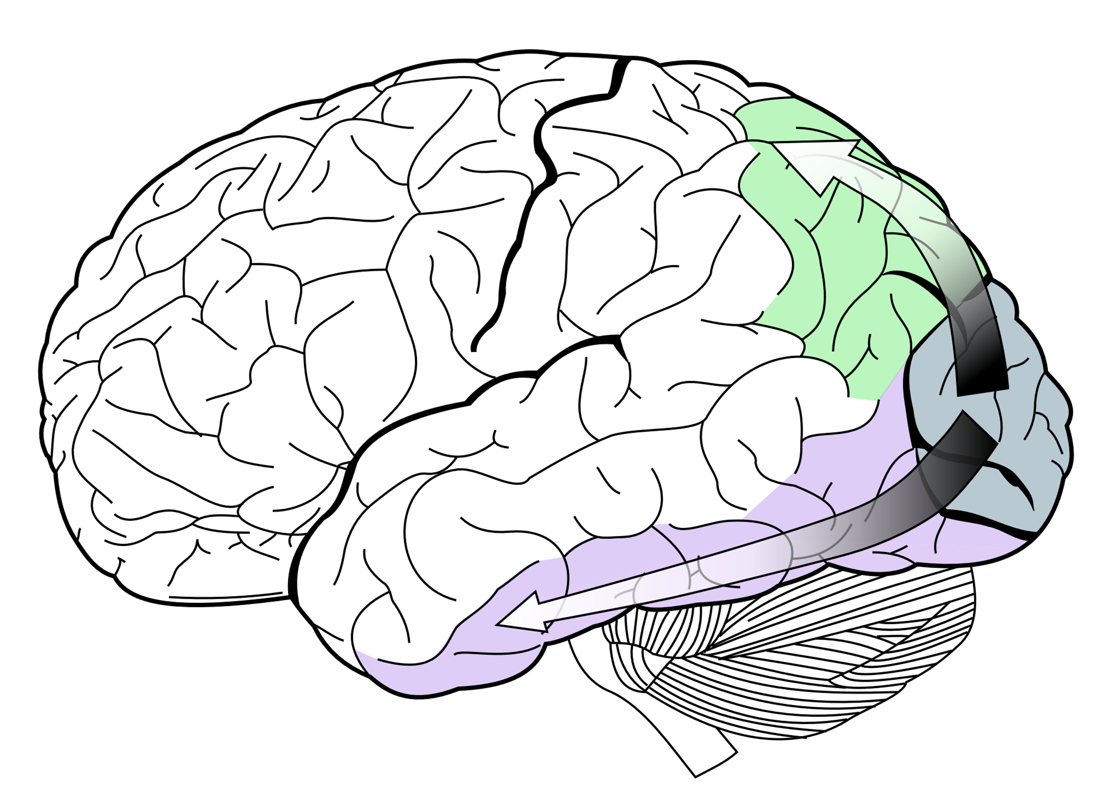
Two-stream hypothesis
Dorsal stream: «where» pathway
Model of the neural processing of vision in primates
Principles of object recognition have been extensively studied in macaque face patch system
Chang and Tsao, The code for facial identity in the primate brain, (2017)
Tsao, et al., Mechanisms of face perception, (2008).
Ventral stream:
«What» pathway
https://en.wikipedia.org/wiki/Two-streams_hypothesis
Notes:
- In neuroscience there is this hyp called, …, which is a model for …
Image
In particular, …

Slide 15
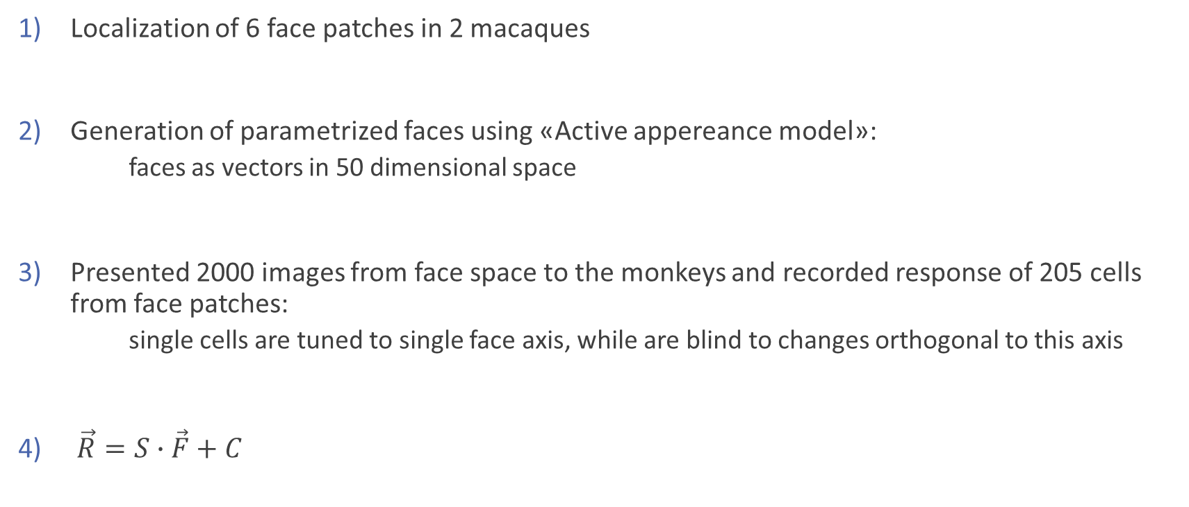
Code for facial identity in macque’s brain
Localization of 6 face patches in 2 macaques
Generation of parametrized faces using «Active appereance model»:
faces as vectors in 50 dimensional space
Presented 2000 images from face space to the monkeys and recorded response of 205 cells from face patches:
single cells are tuned to single face axis, while are blind to changes orthogonal to this axis
$\vec{R}=S∙\vec{F}+C$
Chang and Tsao, The code for facial identity in the primate brain, (2017)

Slide 16
Learning objective
Single neurons encode orthogonal axes of variation in face space
How these representations arise through learning of the statistics of visual input?
Why β-VAE?
Reconstruction of images from low dimensional embeddings
Regularization to learn semantically meaningful representaitons
Unsupervised framework resembles untutored statistical learning in visual developments
Slone et al., Infants’ statistical learning: 2- and 5-month-olds’ segmentation of continuous visual sequences, (2015)
Notes:
To summarize,
However, open question is … solution BetaVAE
Because, …

Slide 17
Semantic disentanglement in inferotemporal face patch neurons
Notes:
Now I’m finally going to talk about the paper which motivated me to dig deeper into this subject, and I’m going to start citing a phrase from the paper, to contextualize the study

Slide 18
« In order to better understand how the brain perceive faces, it is important to know what objective drives learning in the ventral visual stream. […]
We model neural responses to faces in the macaque inferotemporal (IT) cortex with a deep self-supervised generative model, β-VAE, which disentangles sensory data into interpretable latent factors, such as gender or age.
Our results demonstrate a strong correspondance between the generative factors discovered by β-VAE and those coded by single IT neurons […]. »
goal
content
results
Higgins et al., Unsupervised deep learning identifies semantic disentanglement in single inferotemporal face patch neurons, (2021).
Notes:
The goal of the paper is …
To achieve this goal they model …
The results that they obtained demonstrate …

Slide 19
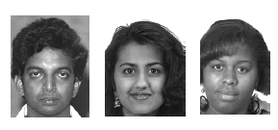
Dataset
Neural recordings from 159 neurons in macaque face patch while viewing 2100 natural face image
Artificial neural data
Neural subsets data
Chang et al., Explaining face representation in the primate brain using different computational models (2021).
Notes:
Starting with the dataset that they used, it consists of … from different publicly available faces db
From this dataset, they created …
Artificialy by linearly combining
And smaller subsets of original 159 neurons
It will be clear why later on

Slide 20
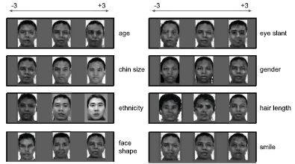
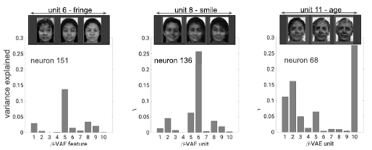
Single disentangled units explain activity of single neurons
Train β-VAE on same image dataset:
11 latent units
Human interpretability
32% humans agreed on single distinct semantic label per unit
Latent units explain neurons response variance
Higgins et al., Unsupervised deep learning identifies semantic disentanglement in single inferotemporal face patch neurons, (2021).

Slide 21
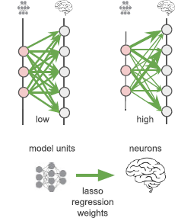
Neural alignment score
Measures how well the response of single neurons are explained by single model units
4 measures
1 = perfect
0 = bad
Subset to real
Redundancy
Subset to subset
Theoretical ceiling
Subset to β-VAE
Match with theoretical ceiling
Higgins et al., Unsupervised deep learning identifies semantic disentanglement in single inferotemporal face patch neurons, (2021).
Artificial to β-VAE
Low alignment score
Notes:
But to quantify this effect, they used a metric called neural alignment score
Metrics that …
This score is based on a lasso regression between latent units, … Intuitively, as shown in the images
To asses these correspondances, they performed 4 measure of this alignment score

Slide 22
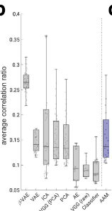
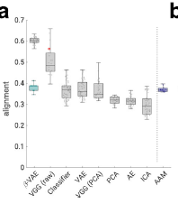
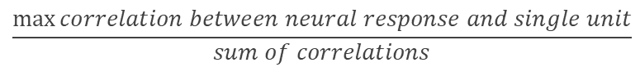
All aspects of disentanglement objective are important
Neural alignment statistically higher in β-VAE
Average correlation ratio statistically higher in β-VAE
$$\frac{\max{correlation between neural response and single unit}}{sum of correlations}$$
Higgins et al., Unsupervised deep learning identifies semantic disentanglement in single inferotemporal face patch neurons, (2021).
Notes:
Next, they compared the neural slignment score with a number of rival models, for example VGG latent units were considered deepest layers plus PCA to mathc idmensionality, ot they directly pplied PCA do neural recordings of 159, …
As shwon from the firs graph, neural alignm of … statistically higher
To validate these results, they computed another statistic which is …

Slide 23
Conclusions
Axes of variation represented by single IT neurons align with single disentangled latent units discovered by the β-VAE.
Latent units found by β-VAE are not sufficient to fully describe the whole space of faces
Connection between neural coding in IT cortex and deep generative model can be generalized beyond face domain into more complex visual stimuli
Ventral visual stream may also be optimizing
the disentangling learning objective
Notes:
To summarize, the conclusions achieved by the paper are:
… so this strong correspondence together with the self-sup framework of betaVAE suggest that
One main limitation is that …, this is due to the fact that the architecture needs a larg db to achieve optimal recon quality and optima disentangling prop
However, the results obtained by the paper, in particular the connection … are promising because this connection can be generalized beyond face domain into more complex visual stimuli, to have a deeper understanding of the representations coded at single neuron level in the ventral visual stream

Slide 24
β-VAE on animal faces

Slide 25
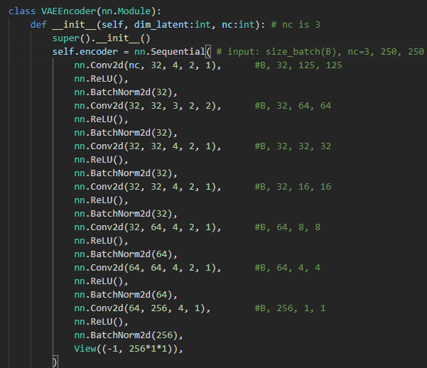
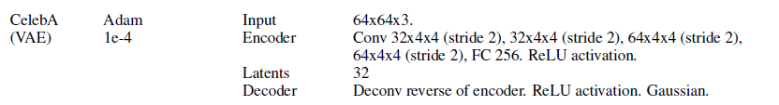
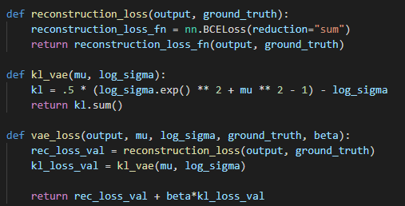
β-VAE implementation
Higgins et al. β-VAE: learning basic visual concepts with a constrained variational framework, (2017)

Slide 26
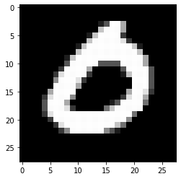
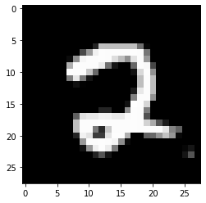
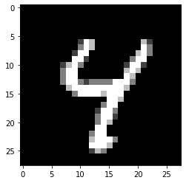
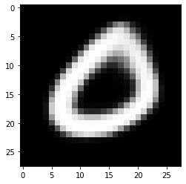
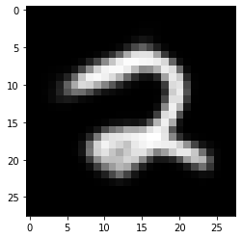
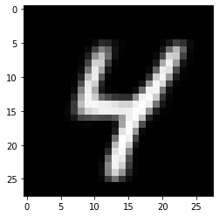
β-VAE on MNIST (β = 1)

Slide 27
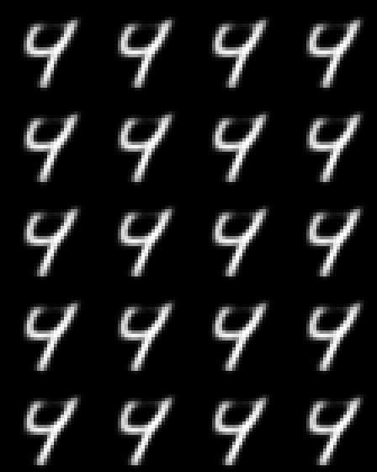
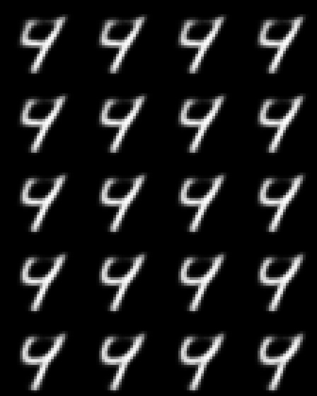
β-VAE on MNIST (β = 1)
feature 10
feature 16

Slide 28
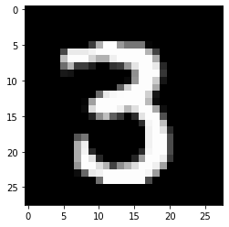
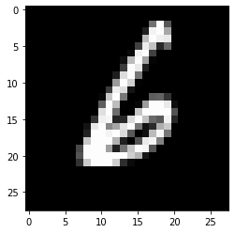
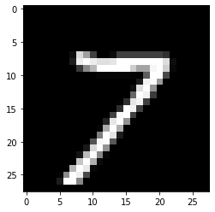
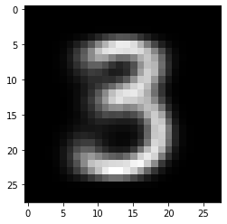
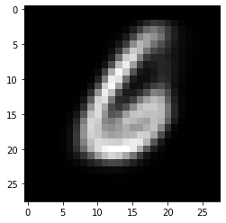
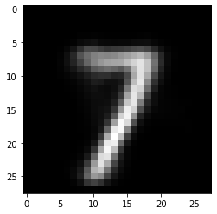
β-VAE on MNIST (β = 5)

Slide 29
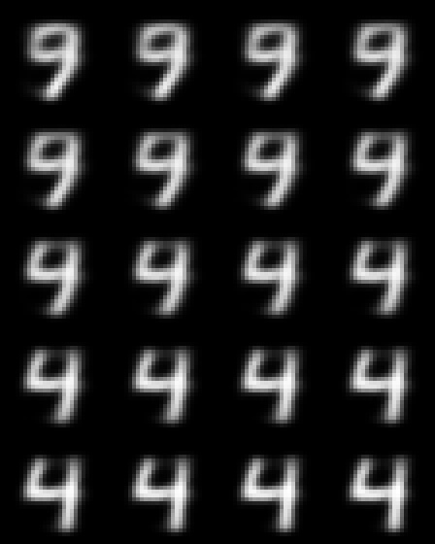
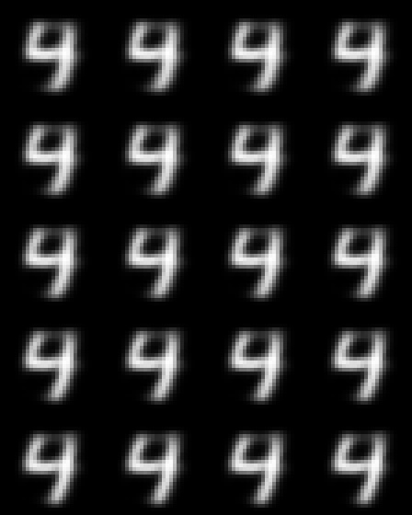
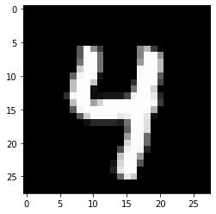
β-VAE on MNIST (β = 5)
feature 10
feature 16

Slide 30
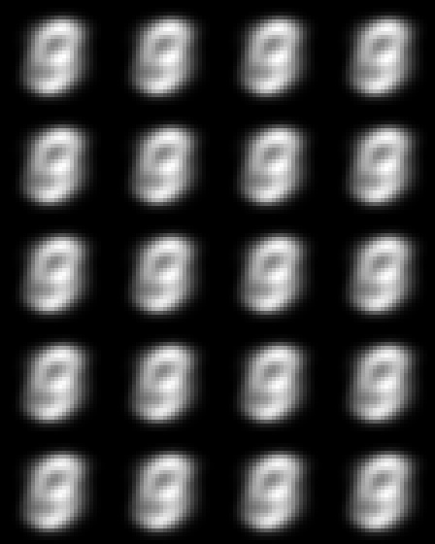
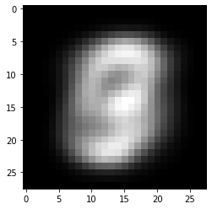
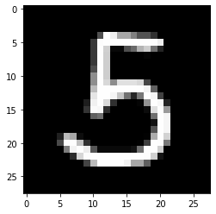
β-VAE on MNIST (β = 120)

Slide 31
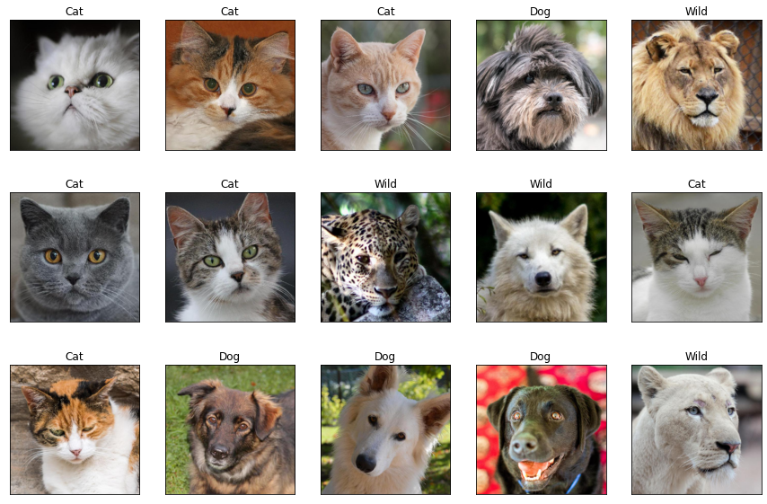
β-VAE on AFHQ
16,130 animal faces (250x250 pixels)
Notes:
- Moving to the animal faces dataset, it consists of 16 000 images from 3 different categories, cats, dogs and wild animals, each with approximately 500 timages.
Original idea was … three cases on each of the category
Said idea because I Did not take into consideration the time

Slide 32
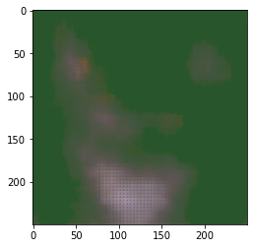




β-VAE on Cats (β = 1)
50 epochs
2800 epochs
700 epochs:
11 hrs on ORFEO
4200 epochs

Slide 33



β-VAE on Cats (β = 1)
feature 0
feature 30
Notes:
Even on the case of latent space traversal, indipendently on the feature, the reconstruction quality is too bad to tell whether a specific feature is aligned to a specific generative factor

Slide 34

β-VAE on Cats (β = 1)
feature 0

Slide 35

β-VAE on Cats (β = 1)
feature 30

Slide 36






β-VAE on Cats (β = 120)
4200 epochs:

Slide 37




β-VAE on Cats (β = 120)

Slide 38

β-VAE on Cats (β = 120)
feature 0

Slide 39
Conclusions:
Computational resources
Model too hard to train
Too complex images
Bad assumption on pixel distribution
Enlarge latent space dimension
Notes:
To conclude and highlight problems that I ecountered and possible improvements:
Clearly did not have enough, …, maybe more could lead to better results
There could be problems with the implementations of the BetaVAE that I did, maybe it was too hard to train
Or the images were to complex, both regarding the computational part (too big) but also the variability in the dataset → network not able to disentagle generative factors cause they were too complex
Another possible influence on this bad results could be the a bad assumpt on pixels → Bernoulli
Lastly, a possible improvement could be obtained by enlargin the latent space dim, so that the channels would have more capacity tor tansmit info leading to higher reconstruction quality

Slide 40
Thank you for you attention
«An AI must fundamentally understand the world around us, and we argue that this can only be achieved if it can learn to identifiy and disentangle the underlying explanatory factors hidden in the observed milieu of low level sensory data»
Bengio et al., Representation Learning: A Review and New Perspectives, (2014).

Slide 42

Reparametrization trick
https://www.jeremyjordan.me/variational-autoencoders/

Slide 43

https://towardsdatascience.com/intuitively-understanding-variational-autoencoders-1bfe67eb5daf

Slide 44


Slide 45

Disentangled units are sufficient to decode novel faces
During training omission of 62 faces seen by the monkeys
Decoder applied to latent unit predicted from activity of subset of neurons that best aligned with each model unit
Disentangled units carried sufficient information to decode unseen faces
Higgins et al., Unsupervised deep learning identifies semantic disentanglement in single inferotemporal face patch neurons, (2021).
Notes:
Another result they obtained was that dis units ….
In Particular they omitted during training of betaVAE …
Instead of feeding these 62 faces to the encoder and sampling tha latent units from there for reconstruction, they use prediction of subset …

